Slide 1
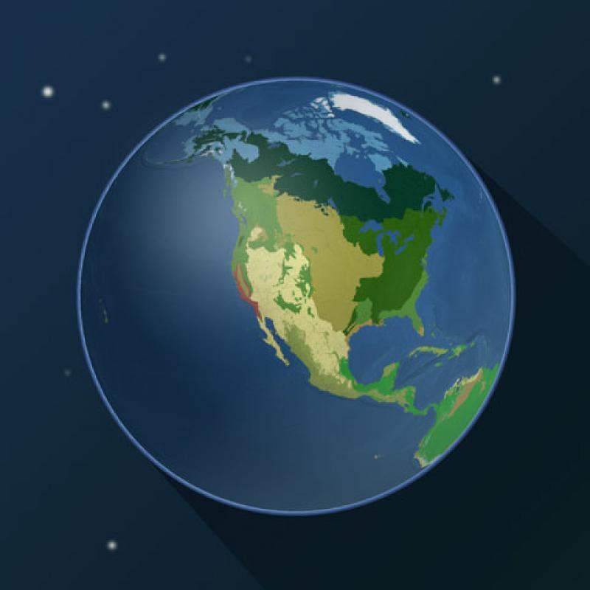
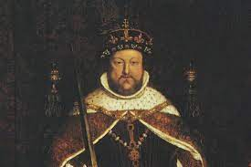
Our theme this term are..
Biomes and
Tudor Monarchs
English
We will be reading ‘The Invention of Hugo Cabret’ and using it as inspiration for our final written outcome of a biography. We will be gathering our ideas through writing diaries, journalistic writing, flashback narrative, speech, discussion, letter, and a film critique. We will use these books to learn how to use apostrophes for contractions, passive voice, adverbs of possibility and question tags.
Maths
We will be learning the concept of Ratio and how to reason and problem solve and looking at similarities and difference to fractions. We will then be moving onto scale drawing and using scale factors. Then we will move onto Algebra and understanding which includes looking at substitution and formulae and how solve equations. After that we will move on looking at decimals.
Science
This half-term we will be learning about Earth and Space. We will be looking at the shape and the relative sizes of the Earth, Sun and Moon. The children will investigate the idea of Earth’s rotation to explain day and night and the apparent movement of the sun across the sky.
RE
In our RE we are looking at Hinduism and our enquiry question is: Do beliefs in Karma, Samsara and Moksha help Sanatanis lead good lives? Through the term they will learning about consequences, choices, reincarnation, Dharma (duty), Karma (action) and how to live a good life.
Computing
We will be learning about 3D modelling and learning how to design simple and more complex objects as well as electrical circuits. The pupils will be able to use their coding knowledge. Pupils will be designing and modifying their objects.
History
We will be learning the Tudors. The pupils will further their knowledge by looking at the Battle of Bosworth and that was won; The Tudor monarchs and how the most famous Kings and Queens came from the Tudor family. The children will also be learning about the past times and beliefs in the era of the Tudors.
PSHE
We will be thinking about our dreams and goals. The children will work on their steps to success to achieve their dreams and goals with a positive attitude and perseverance.
PE
This half-term we will be learning about gymnastics and how to develop a range of skills: flexibility, strength, technique, control and balance.
Music
We will be learning how to perform and compose music using pitch, rhythm, pulse and form. We will also be continue learning how learn how to play the Ukulele.
French – Year 6
We will be learning about regular and irregular verbs. They will learn the terminology and patterns involved in regular whole verb conjugation.
Art
We will be learning Art and Fashion and the artist Piet Mondrian. The pupils will investigate the success of the collaboration between artist Pablo Picasso and the fashion designer Coco Chanel in the 1920s. They will also be creating and investigating Op art design using line and colour in the style of Victor Vasarely.

