Slide 1
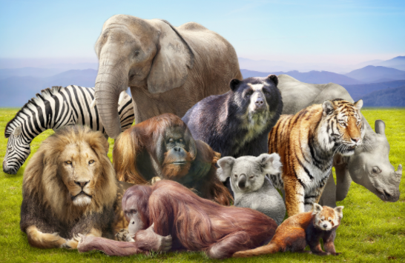
Our theme this term is…
Walking Through
the Jungle.
English (Writing)
We will be focusing on these three texts: The Magic Paintbrush Little Red Super Milly and the Super School Day. We will use these books to learn how to create signs and labels, captions, invitations and letters.
Maths
We will be focusing on a range of Maths topics this half term to build on our mathematical skills including: Numbers 6, 7, 8 Even and Odd numbers Combining 2 groups (addition) Measuring length and height Spatial Reasoning
Phonics
We will be learning Reception Spring 1 phonemes. Diagraphs: ai, ee, oa, oo (long and short sound), ar, or, ur, ow, oi, er, dd, mm, tt, bb, rr, gg, pp, ff. Trigraphs: igh, ear, air. We will also be learning a range of tricky words, how to decode and blend to read words, how to segment to spell words and how to chunk up longer words to read them.
Expressive Arts and Design
Creating with Materials: We will be learning to create collaboratively, working together to develop and realise creative ideas- linked to animal habitats. Being Imaginative and Expressive: We will be learning to listen, think, play and exploring timbre.
Understanding the World
Understanding the world is split into 3 sections: The Natural World, Past and Present and People, Culture and Communities. The Natural World: we will be learning about animals including: different categories of animals, nocturnal animals, seasonal changes- growth and change over time. Past and Present (history link): we will be talking about members of our immediate family and community. People, Culture and Communities (RE link): we will be learning about Islam, Lunar New Year and understanding that some places are special to members of their community.
PSED
Jigsaw PSED unit: our dreams and goals.
PE
Experimenting with different ways of moving, jumping and landing appropriately.
Music
Continue to develop control of singing voice. Take turns in musical activities and songs.

