Slide 1
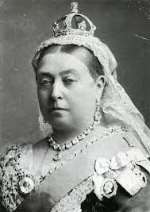
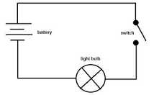
Our theme this term are..
Victorians and
Circuits
English
We will be using the texts: Blackberry Blue and other fairy tales, where the pupils will be creating their own ‘warped / twisted’ fairy tale at the end of the unit and the purpose will be to entertain their reader. The pupils will then will onto the text survivors where they will be writing their own biographical event about a person of their choosing who has accomplished something extraordinary.
Maths
We will be learning the concept of ratio and proportion – where they will be solving problems involving relative sizes of two quantities where missing values can be found and then moving onto measurement and statistics. As the Spring term comes to a close, the Year 6’s will be revising the topics learnt in preparation for the oncoming SATs assessments which will be held in May.
Science
This half-term we will be learning about circuits and how the components fit into them. We will also be learning the symbols used to create circuit diagrams. We will be investigating at the impact of batteries/ cells on a circuit
RE
In our RE we are looking at a Christianity Unit: Is Christianity still a strong religion over 2000 years after Jesus was on Earth? The pupils will discuss different types of festivals and celebrations and what they demonstrate about Christianity.
Computing
We will produce 3D models. We will be working in a 3D space, moving, resizing, and duplicating objects. combine multiple objects to create a model of a desk tidy. They will then go on to plan, develop, and evaluate their own 3D model of a building.
History
We will be learning the Victorians and how it was an important era of invention and exploration. We will be looking at the impact of the industrial revolution alongside the positive and negative consequences of the British Empire.
PSHE
We will be thinking about a ‘Healthy Me’. The pupils will be looking at: healthy choices they make, balanced diets, physical exercises, managing stress and pressure.
PE
This half-term we will be learning about gymnastics. The pupils will learn how to combine and link actions and relate this with a partner and apparatus.
Music
We will be learning how to perform and compose music using pitch, rhythm, pulse and form. We will also be continue learning how learn to compose a piece of music.
French – Year 6
We will be learning about ‘The Weekend’. Ask what the time is and tell the time accurately. They will learn how to say what they do at the weekend.
DT / Art
We will be designing and building bridges using key features such as Vouissers and keystones. In Art we will be exploring cultural tradition through Kimbo.

