Slide 1
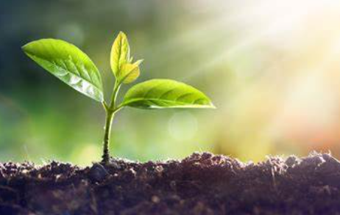
Our theme this half term is…
Growing and
Spring.
English (Writing)
We will be focusing on these two texts: Little Red Hen Jack and the Beanstalk Our outcomes for our writing will be: Lists Labels and captions Re-telling Narratives Letters Instructions
Maths
Length, height and time Building 9 and 10 Explore 3-D shapes
Understanding the World
Geography link: Investigating patterns: seeing where their country is in the world in relation to others using globes, world maps. Investigating the impact of Geographical processes: Understand the effect of changing weather/ seasons on the natural world around them. Science link: Weather and Seasonal changes (physics) Animals and Plants (biology) Materials (chemistry)
RE
Discuss and learn: Thematic Unit: How can we help others when they need it?
Computing
We will learn how to code and direct code-a-pillars around the classroom avoiding obstacles. Learn how to use key features of a computer to access and use websites such as Phonics Play.
Expressive Arts and Design
Exploring the skills of collage. Textiles- fabrics, threads and simple running stitch. Role Play- developing storylines.
PSHE
We will be exploring and discussing all about 'Healthy Me'.
Physical Development
This half term in PE we are working on our balancing skills and an introduction to gymnastics.
Communication and Language
We will: Learn new vocabulary Describe some events in detail Use new vocabulary in different contexts

