Slide 1
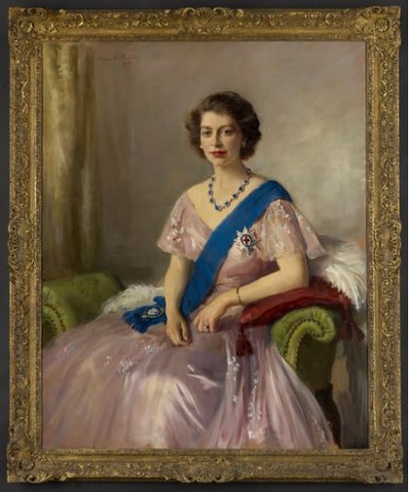
Our themes this term are..
Important People and Portraits
English
We will begin the year by looking at narrative. We will secure our knowledge of writing a simple sentence – beginning with a capital letter, ending with a full stop and checking the everything makes sense - and then begin using conjunctions ‘and’, ‘but’ and ‘or’ to link ideas together. We will use expanded noun phrases to add more detail to character and setting.
Maths
In Maths we will be exploring place value. We will be securing our knowledge of numbers to 100; being able to represent using different mathematical equipment, partition them into tens and ones as well as placing them in order. We will then move to applying partition techniques to begin adding and subtracting two-digit numbers.
Science
This half-term we will be learning about everyday materials and their properties. We will be talking about the suitability of materials for certain objects as well as looking at how the properties of materials can change in certain conditions.
RE
We will be looking at what the time of harvest means to different religions. We will look at how different religions promote sharing within the community.
Computing
We will develop their understanding of what information technology (IT) is and will begin to identify examples in school and beyond. We will then investigate how IT improves our world and will learn about the importance of using IT responsibly.
History / Geography
We are developing a deeper understanding of the impact of Queen Elizabeth II’s reign. We will explore the roles and responsibilities of a monarch as well as constructing a detailed timeline of Queen Elizabeth’s life.
PSHE
We will be looing at our hopes and dreams for the next year, as well as discussing how to deal with any worries we might have. We will also explore rights and responsibilities and how these can ink to rewards and consequences.
PE
Children will develop the fundamental skills of balancing, running, changing direction, jumping, hopping and skipping. They will be given the opportunity to work with a range of different equipment.
Music
We will begin our weekly sessions with Mr Randall, our music teacher. We will begin by exploring a range of instruments, noting the different sounds they can make, and practising some basic orchestra skills.
Art
We will be looking at the work of Thomas Gainsborough and the style they applied to their portraits. We will be aiming to replicate these techniques in our own self portraits.

