Slide 1
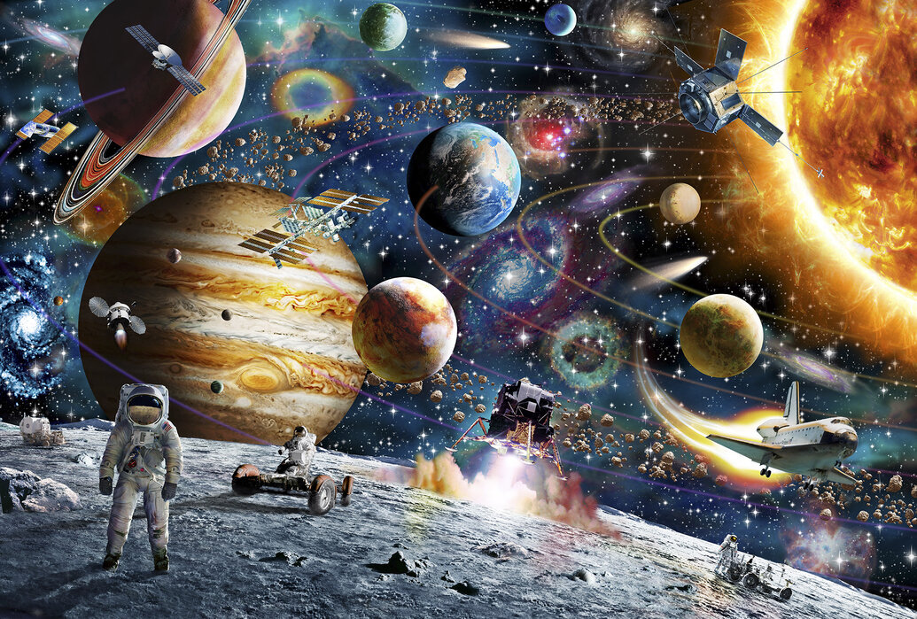
Our theme this half term is…
Space
English (Writing)
We will be focusing on these books and traditional tales: Astro girl, The Ugly Duckling, Aliens love underpants, Tiddler, The Frog Prince, A Little Bit Brave, The Princess and the Pea. We will use these books to write captions, phrases simple sentences and descriptive sentences.
Maths
Doubling and Halving- solving problems involving doubling and halving. Odd and Even- Understanding that numbers are either odd or even, looking at their ‘composition’ and whether they share fairly into two groups. Counting beyond 20-recognising the pattern of the counting system, exploring the value of tens and ones in numbers.
Phonics
We will be revising Phase 4 graphemes. We will be learning: Long vowel sounds CVCC CCVC, long vowel sounds CCVC CCCVC CCV CCVCC, Phase 4 words ending –s /s/, Phase 4 words ending –s /z/, Phase 4 words ending –es, longer words, root word ending in: –ing, –ed /t/, –ed /id/ /ed/, –ed /d/, Phase 4 words ending in: –s /s/, –s /z/, –es, longer words. We will be reviewing all taught tricky words.
Expressive Arts and Design
Creating with Materials: Drawing and Painting: Artist link- Vincent Van Gogh: draw/paint lines of varying thickness using dots and lines for pattern/texture. Use a variety of brushes and tools. Describe people, objects and places using simple art specific language especially related to colour and shape. Collage: Joins items with have been cut, torn or glued. Join items in a variety of ways – sellotape, masking tape, string, ribbon Textiles: (Alien hand puppets, Superhero Capes): handling and manipulating fabric, thread and needles with support for sewing felt. Using fabrics to make simple puppets, capes for ‘Supertato’.
Understanding the World
Understanding the world is split into 3 sections: The Natural World, Past and Present and People, Culture and Communities. The Natural World (science link): Animals (biology): Learn about and observe the lifecycle of a tadpole/ frog/ and caterpillar/butterfly. Name and describe a range of minibeasts that can be found in the school grounds. Categorise and compare animals by habitat. Electricity (physics): Explore how to make programmable toys and torches work. Materials (chemistry): Explore dissolving and mixing with sugar in water and squash and water. Past and Present (History link): Learning from history: Discuss the Moon landing and the life of Neil Armstrong and the other astronauts who landed on the moon with him. They will consider how their lives are different from the lives of people in the past. Communicating historically: Encourage children to use expressions like ‘once upon a time’, ‘then and now’, ‘a long time ago’, ‘when I grow up’.
PSED
Jigsaw PSED unit: Changing Me- Coping positively with change.
PE
Developing running, balancing and coordination skills ready for Sports Day!
Music
Revisiting chosen nursery rhymes and/or songs, a context for the History of Music and the very beginnings of the Language of Music.

