Slide 1
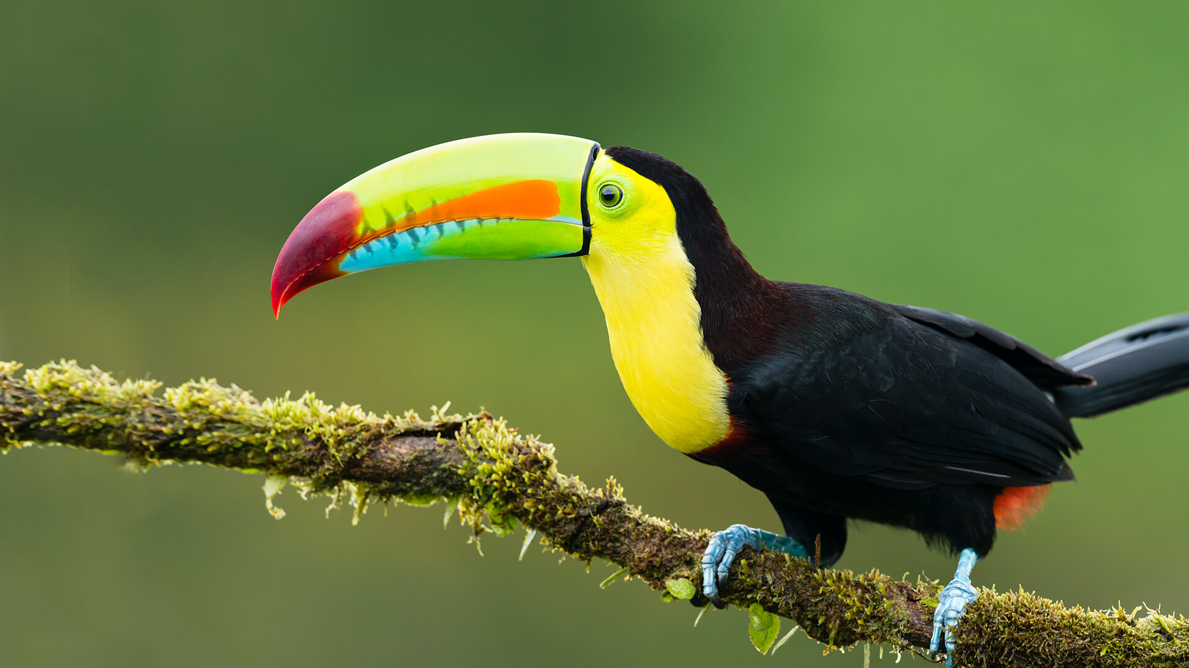
This term in…
Toucan Class
English (Writing)
We will be reading ‘Hidden Figures’ by Margot Lee Shetterly and using it as inspiration to write a memoir from one of our hidden figures highlighting the struggles and successes of working in NASA during segregation. After this, we will read ‘The Tempest’ by William Shakespeare to learn about the structure of a playscript. As our final piece for this unit, we will write our own playscripts.
Maths
We will finish off our multiplication and division unit this half –term by multiplying and dividing by 10, 100 and 1,000. This will be followed by fractions where we will be learning about equivalent fractions and converting improper to mixed numbers. Then, we will focus on comparing, ordering, adding and subtracting fractions. We will have some time at the end of the term to review what we have learned.
Science
This half- term we will be learning about forces and magnetism. We will continue to be investigating and devising experiments that prove or disprove a hypothesis. As well as building our knowledge and understanding of reliable and unreliable data. We will start the half-term by recapping the force of magnetism before exploring gravity, air resistance, water resistance and friction.
RE
This half-term we will be answering the question, “What does a Christian look like in another country?” To do this we will explore how there are Christians in almost every country. We will consider some of the things Christians may have in common around the world as well as what aspects may be different.
Computing
We will be covering databases this half term. We will start by looking at what a database is before looking at paper based versions and viewing computer databases. We will then use and compare databases before looking at how databases are used in real life.
History
We will be learning all about life in the period of the Ancient Greeks. We will be understanding the ancient civilisation and their legacy within history. As well as looking at the Greeks influence and their impact. The pupils will be learning about the Greek myths and legends and how clues from the past can help us today.
PSHE
Our unit of work is Celebrating Differences where we will be learning about: accepting that we are all different, dreams and goals to make the world a better place.
PE
This half-term we will be swimming. On Tuesdays, we will be learning how to be safe in the water and build on our confidence in the pool.
Music
We will be further learning about the differences between a range of notes and performing songs with increasingly difficult instrument and vocal parts.
French
We will be learning the vocabulary around “Joyeux Noel” so we can learn new vocabulary to describe different aspects of Christmas through French.
Art
We will be looking at the topic of Expressionism and investigate a range of artists. The pupils will be looking at how art can relate to how real images are distorted and exaggerated in order to express their inner feelings. They will be looking at Henri Matisse.

