Slide 1
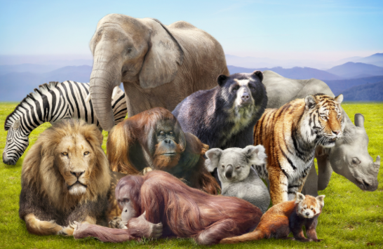
Our theme this half term is…
Animals!
English (Writing)
We will be focusing on these books and traditional tales: Dear Zoo, Chicken Licken, Rosie’s Walk, Little Red Riding Hood, The Tiger who came to tea. We will use these books to learn how to create signs and labels, captions, invitations and letters.
Maths
We will be focusing on a range of Maths topics this half term to build on our mathematical skills including: Counting the sort (including cardinality) Using counting to compare Spatial thinking
Phonics
We will be learning Reception Spring 1 phonemes. Diagraphs: ai, ee, oa, oo (long and short sound), ar, or, ur, ow, oi, er, dd, mm, tt, bb, rr, gg, pp, ff. Trigraphs: igh, ear, air. We will also be learning a range of tricky words, how to decode and blend to read words, how to segment to spell words and how to chunk up longer words to read them.
Expressive Arts and Design
Creating with Materials: Artist study: Paul Klee. Exploring materials, collaging and using a needle and thread for a simple running stitch. Being Imaginative and Expressive: We will use experiences and learnt stories to develop storylines. We will enhance our small world play with simple resources
Understanding the World
Understanding the world is split into 3 sections: The Natural World, Past and Present and People, Culture and Communities. The Natural World (science link): we will be learning about animals including: different categories of animals, nocturnal animals, seasonal changes- growth and change over time. Past and Present (history link): Children will begin to explore the passage of time in familiar scenarios: seasons birthdays, local festivals, familiar routines and stories. Children will: · sequence a life cycle/stages of growth of a plant/animal (Geography link): Investigating patterns: Children will be able to see where their country is in the world in relation to others, using globes, world maps etc. Introduce children to less familiar environments such as coastal environments. People, Culture and Communities (RE link): Celebrations in different cultures and worldviews
PSED
Jigsaw PSED unit: our dreams and goals.
PE
Explore how to use space safely. Explore travelling movements, shapes and balances.
Music
Continue to develop control of singing voice. Take turns in musical activities and songs.

