Slide 1
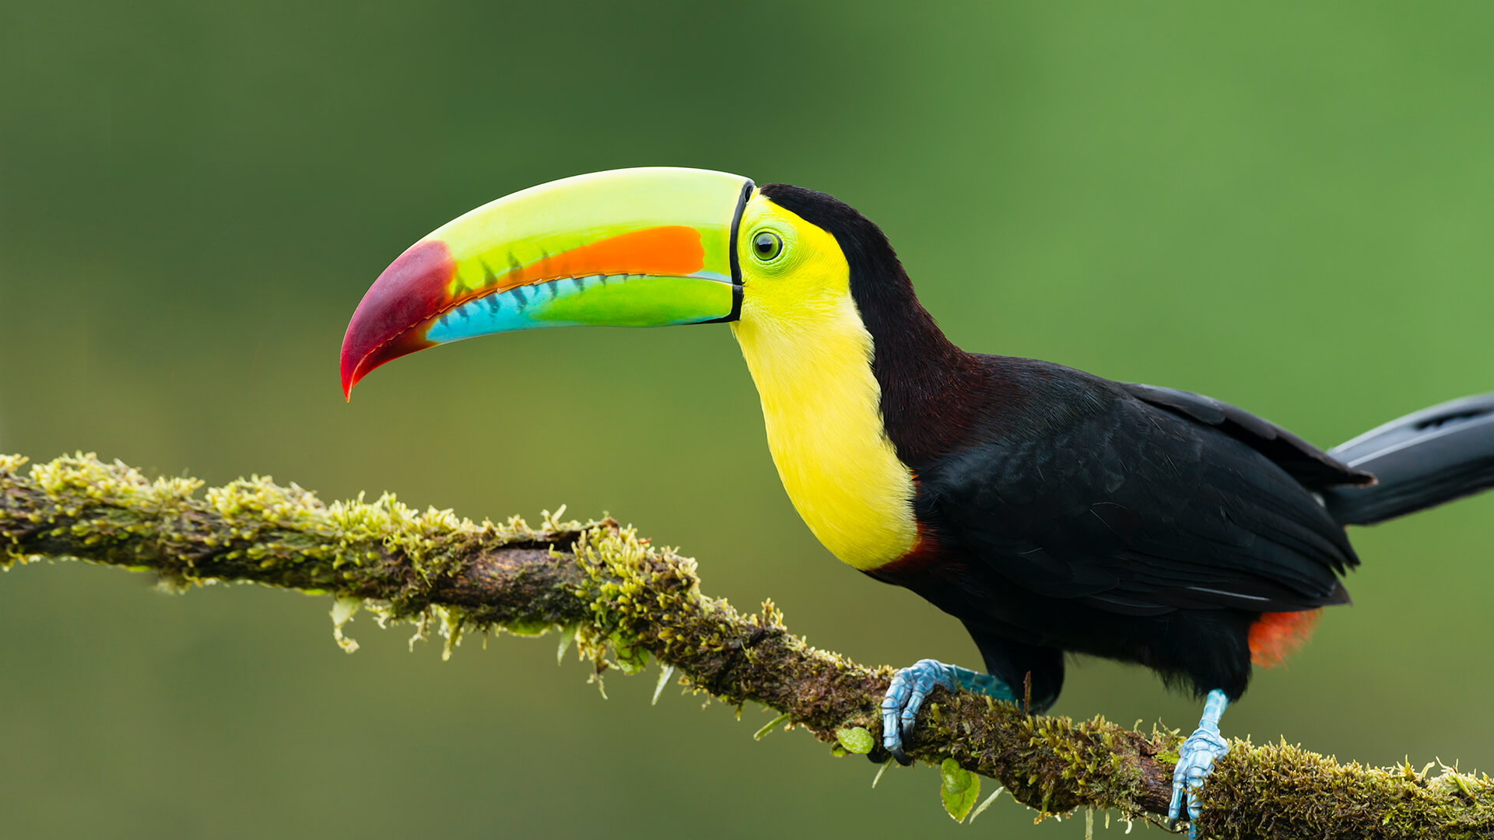
This term in…
Toucan Class
English (Writing)
We will be reading ‘The World of the Unknown: Monsters’ by Carey Miller and ‘The Book of Mythical Beasts and Magical Creatures’ by Stephen Krensky. We are using these to create a non-chronological report based on their own invented ‘monster’ or fictional creature. After this, we will be writing a detailed setting description for our peers using the text ‘Cloud Tea Monkeys’ by Mal Peet.
Maths
We will be covering Place Value to start the half-term by looking at numbers up to 1,000,000. This will be followed by focussing on mental calculation of the four different operations (addition, subtraction, multiplication and division). Learning different strategies to help us with mental arithmetic. We will also be building on the formal methods of the 4 operations to help strengthen our efficiency and accuracy.
Science
This half- term we will be learning about properties of materials. We will compare and group materials based different investigations. We will help solve everyday issues caused by the amazing array of material properties. This will be achieved by carrying out a series of tests to identify the best materials for different jobs.
RE
This half-term we will be answering the question, “What motivates Humanists to lead good lives?”. To do this we will explore the unique aspects of Humanism and learn more about how their beliefs shaped the lives and careers of famous Humanists.
Computing
We will be covering computing systems and networks this half term. We will start by looking at what a system is in everyday life before looking at how a computing system operates. Then, we will explore how a computing network works and how data can be exchanged.
History
In History, we will be learning all about life in Ancient Greece! Focusing on city-states like Athens and Sparta, the invention of democracy, and the unique culture including Greek myths, powerful gods, the Olympic Games, and lasting architectural styles.
PSHE
We will be thinking about what we would like to be when we are older while examining different types of careers and their value to society.
PE
This half-term we will be learning the skills needed to practice Tag Rugby. We will be using an array of invasion games skills.
Music
We will be learning about rock music through singing and playing instruments. We will putting together a whole class performance of Bon Jovi’s ‘Livin’ on a Prayer’.
French
We will be learning the vocabulary around “chez moi” so we can describe what house and area we live in. We will be speaking, reading and listening in each lesson.
Art
For Art, we will be learning about Surrealism. We will explore the artwork of artists such as Salvador Dali and René Magritte. We will learn about how this movement became popular in the 1920s and how these artists explored fantasy and absurdity to create their own art. This will help us create our own surrealist pieces of art.

