Slide 1
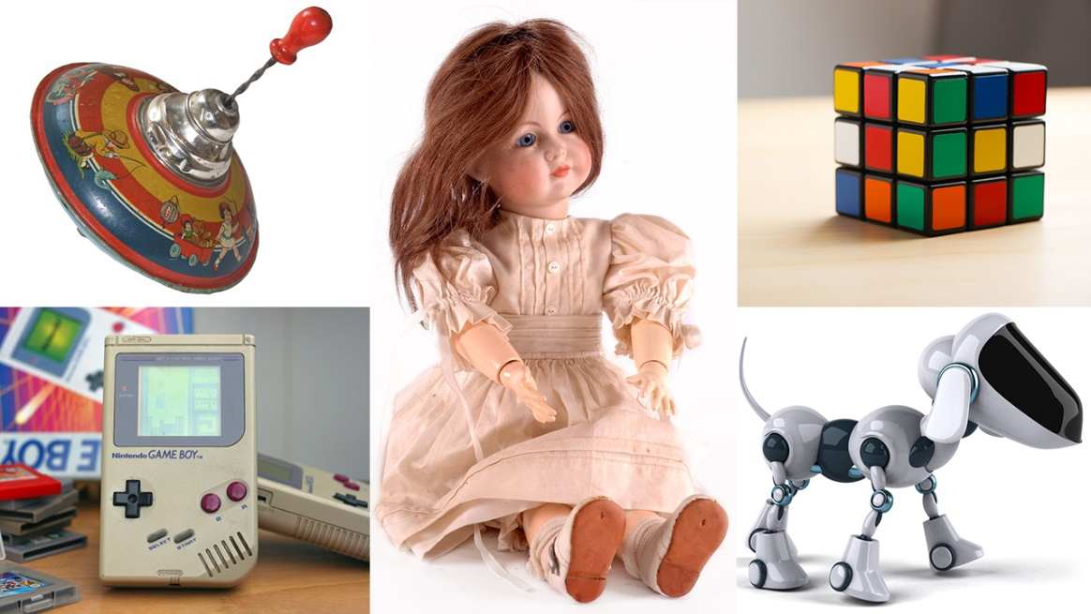
Our theme this term is…
Toys
Understanding the World
We will be comparing the difference between ‘modern’ and ‘old’ by comparing toys from different time periods. We will begin to look at and create simple maps of our classroom environment, using symbols and pictures to represent areas. In Science, we will investigate floating, sinking, melting and freezing., as well as looking at seasonal changes.
Expressive Arts and Design
We will continue to develop storylines in our performance area. In Art, we will be exploring colours and fabrics to create different pieces. We will be using musical instruments to play in time to a simple beat and will talk about how different pieces of music makes us feel.
English (Writing)
We will be orally retelling stories and will be beginning to apply our phonics knowledge to write simple lists and labels. Our texts will be ‘Look Up’ and ‘Naughty Bus.’
Physical Development
We will be developing our fine motor skills ready for mark making, as well as developing our skills In cutting, threading, moulding and weaving. Our PE sessions involves keeping to a simple beat to compose a small dance sequence.
Personal, Social and Emotional Development
We will be looking at the importance of being healthy, including physical activity, diet and sleep. We will be talking about different emotions and how they can make us act and feel.
English (Reading)
Children will now be bringing home a book from our Little Wandle phonics scheme. We wil be practising reading this book three times a week in group sessions, applying our phonic knowledge, gaining speed and confidence in word recognition and will begin to make comments on what we have read.
Communication and Language
We will continue to develop our language through play and modelled activities. We will build on our ability to hold conversations with a peer by listening and responding. We will discuss our favourite toy, giving descriptions about what it looks like and what it does.
Mathematics
We will be exploring how the numbers 1-5 can be made in different ways and introducing mathematical symbols to represent this. We will be looking at what makes a circle and a triangle what they are, using mathematical language to describe their properties and looking for ‘almoat’ triangles and circles

