Slide 1
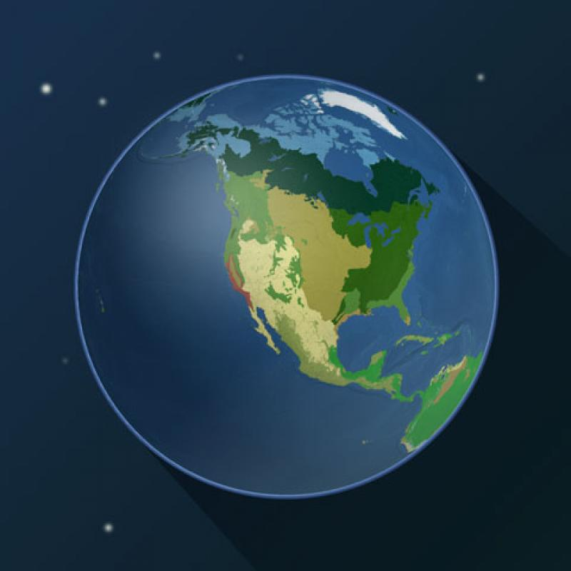
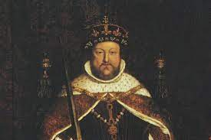
Our theme this term are..
Biomes and
Tudor Monarchs
English
This half term the pupils will be using the text: Arthur Spiderwick’s Field Guide to the Fantastic World Around You. They will be writing a formal non-chronological report in the style of the Spiderwick Field Guide, about an innovated creature of their imagining. We will then move onto writing dialogue to convey character (show not tell) or move the action on.
Maths
We will be learning the order of operation and algebra providing an opportunity for pupils to solve problems using all four operations and understanding of the reasons for the order of operations. We will then look at the formal method for long division and build on the understanding of the relationship between multiplication and division. Finally, we will be moving on to exploring relationships between area and perimeter.
Science
This half-term we will be learning about Earth and Space. We will be looking at the shape and the relative sizes of the Earth, Sun and Moon. The children will investigate the idea of Earth’s rotation to explain day and night and the apparent movement of the sun across the sky.
RE
In our RE we are looking at Christianity - Is anything ever eternal? This enquiry focusses on the Christian understanding of eternity and the Christian belief that God’s love for humankind is eternal in that God will never stop loving humanity.
Computing
We will be learning about spreadsheets. We will be taught how to apply formulas that include a range of cells. We will use spreadsheets to plan an event and answer questions, create charts, and evaluate results in comparison to questions asked.
History
We will be learning the Tudors. The pupils will further their knowledge by looking at the Battle of Bosworth and that was won; The Tudor monarchs and how the most famous Kings and Queens came from the Tudor family. The children will also be learning about the past times and beliefs in the era of the Tudors.
PSHE
We will be thinking about our dreams and goals. The children will work on their steps to success to achieve their dreams and goals with a positive attitude and perseverance.
PE
This half-term the pupils will be learning about developing an idea or theme into dance choreography using formation, timings.
Music
We will be learning how to perform and compose music using pitch, rhythm, pulse and form. The pupils are looking at rap music and using software to compose.
French – Year 6
We will be learning about regular and irregular verbs. They will learn the terminology and patterns involved in regular whole verb conjugation.
Art
We will be learning Art and Fashion and the artist Piet Mondrian. The pupils will investigate the success of the collaboration between artist Pablo Picasso and the fashion designer Coco Chanel in the 1920s. They will also be creating and investigating Op art design using line and colour in the style of Victor Vasarely.

