Slide 1
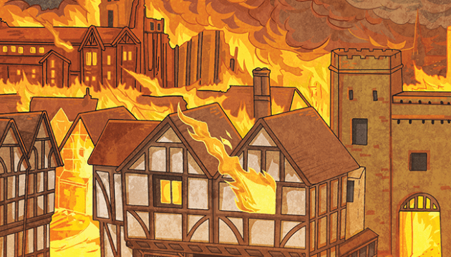
Our topic this half term is…
The Great Fire of London!
English (Writing)
We will be reading ‘The Bear Under the Stairs’ as inspiration for letter writing and innovating our own narratives containing plenty of conjunctions, adverbs, and expanded noun phrases. We will then move to ‘The Great Fire of London’ to support our History topic, exploring writing for purpose with warning posters and tourism leaflets. Drama will be used throughout to imagine the experiences of Londoners at the time.
Maths
We will firstly be revisiting place value and the use of number lines, before moving on to Statistics to learn how to draw and interpret tally charts, pictograms, and block diagrams. Then, we will begin our Division topic, following the ‘concrete, pictorial, abstract’ process to learn the methods of grouping and sharing. We will revise key fluency skills of doubling and halving as well as engage with reasoning problems.
History
We will jump back in time to the 17th century to investigate how people dealt with the Great Plague before moving on to learn all about Pudding Lane and the Great Fire of London, using a combination of primary and secondary sources to uncover the facts and fiction about this infamous event.
RE
Our topic this term is Judaism, with the focus question of ‘Who is Jewish and how do they live?’. We will explore Jewish stories, traditions, and celebrations and make links to other religions in regards to the four concepts of reflecting, thanking, praising, and remembering.
Computing
We will be building on our work in Maths to collect data and use computers to create pictograms and block graphs. We will also be discussing how to keep ourselves safe when online and/or using technology.
DT
We will be learning all about structures and following our DT process of ‘Think, Make, Break, Repeat’ to design and create different types of shell, frame, and solid structures that are stable and strong. The lessons will be a fun mix of theory and practical work, with a final piece inspired by the Great Fire of London.
PSHE
Our topic this half term is ‘Dreams and Goals’. We will firstly be reflecting on our strength and setting achievable targets for the term. Then, we will work together in teams to design a dream garden, whilst practicing skills such as listening, encouragement, and problem solving.
PE
Dance is our sport for this half-term. We will be having loads of fun with dance games and expressive dance activities. We will collaborate to produce a whole-class dance inspired by fire and the Great Fire of London.
Music
With Mr Randall, we will be developing an understanding of pitch through performing and composing. We will also learn about baroque and classical music through listening.
Science
We will observe and discuss seasonal changes in order to create regular weather forecasts for the school. We will also be investigating different materials to learn about their properties and uses in everyday life.

