Slide 1
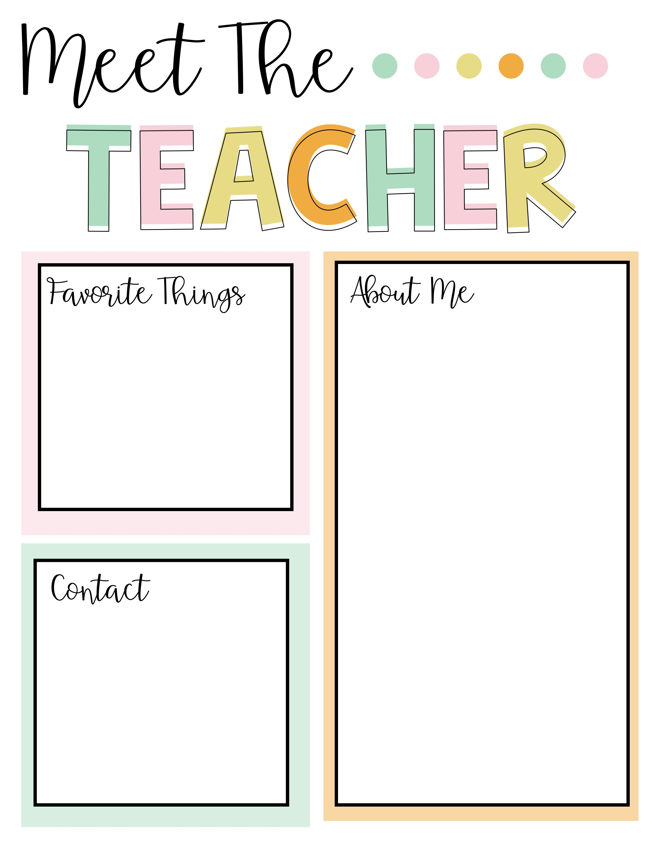
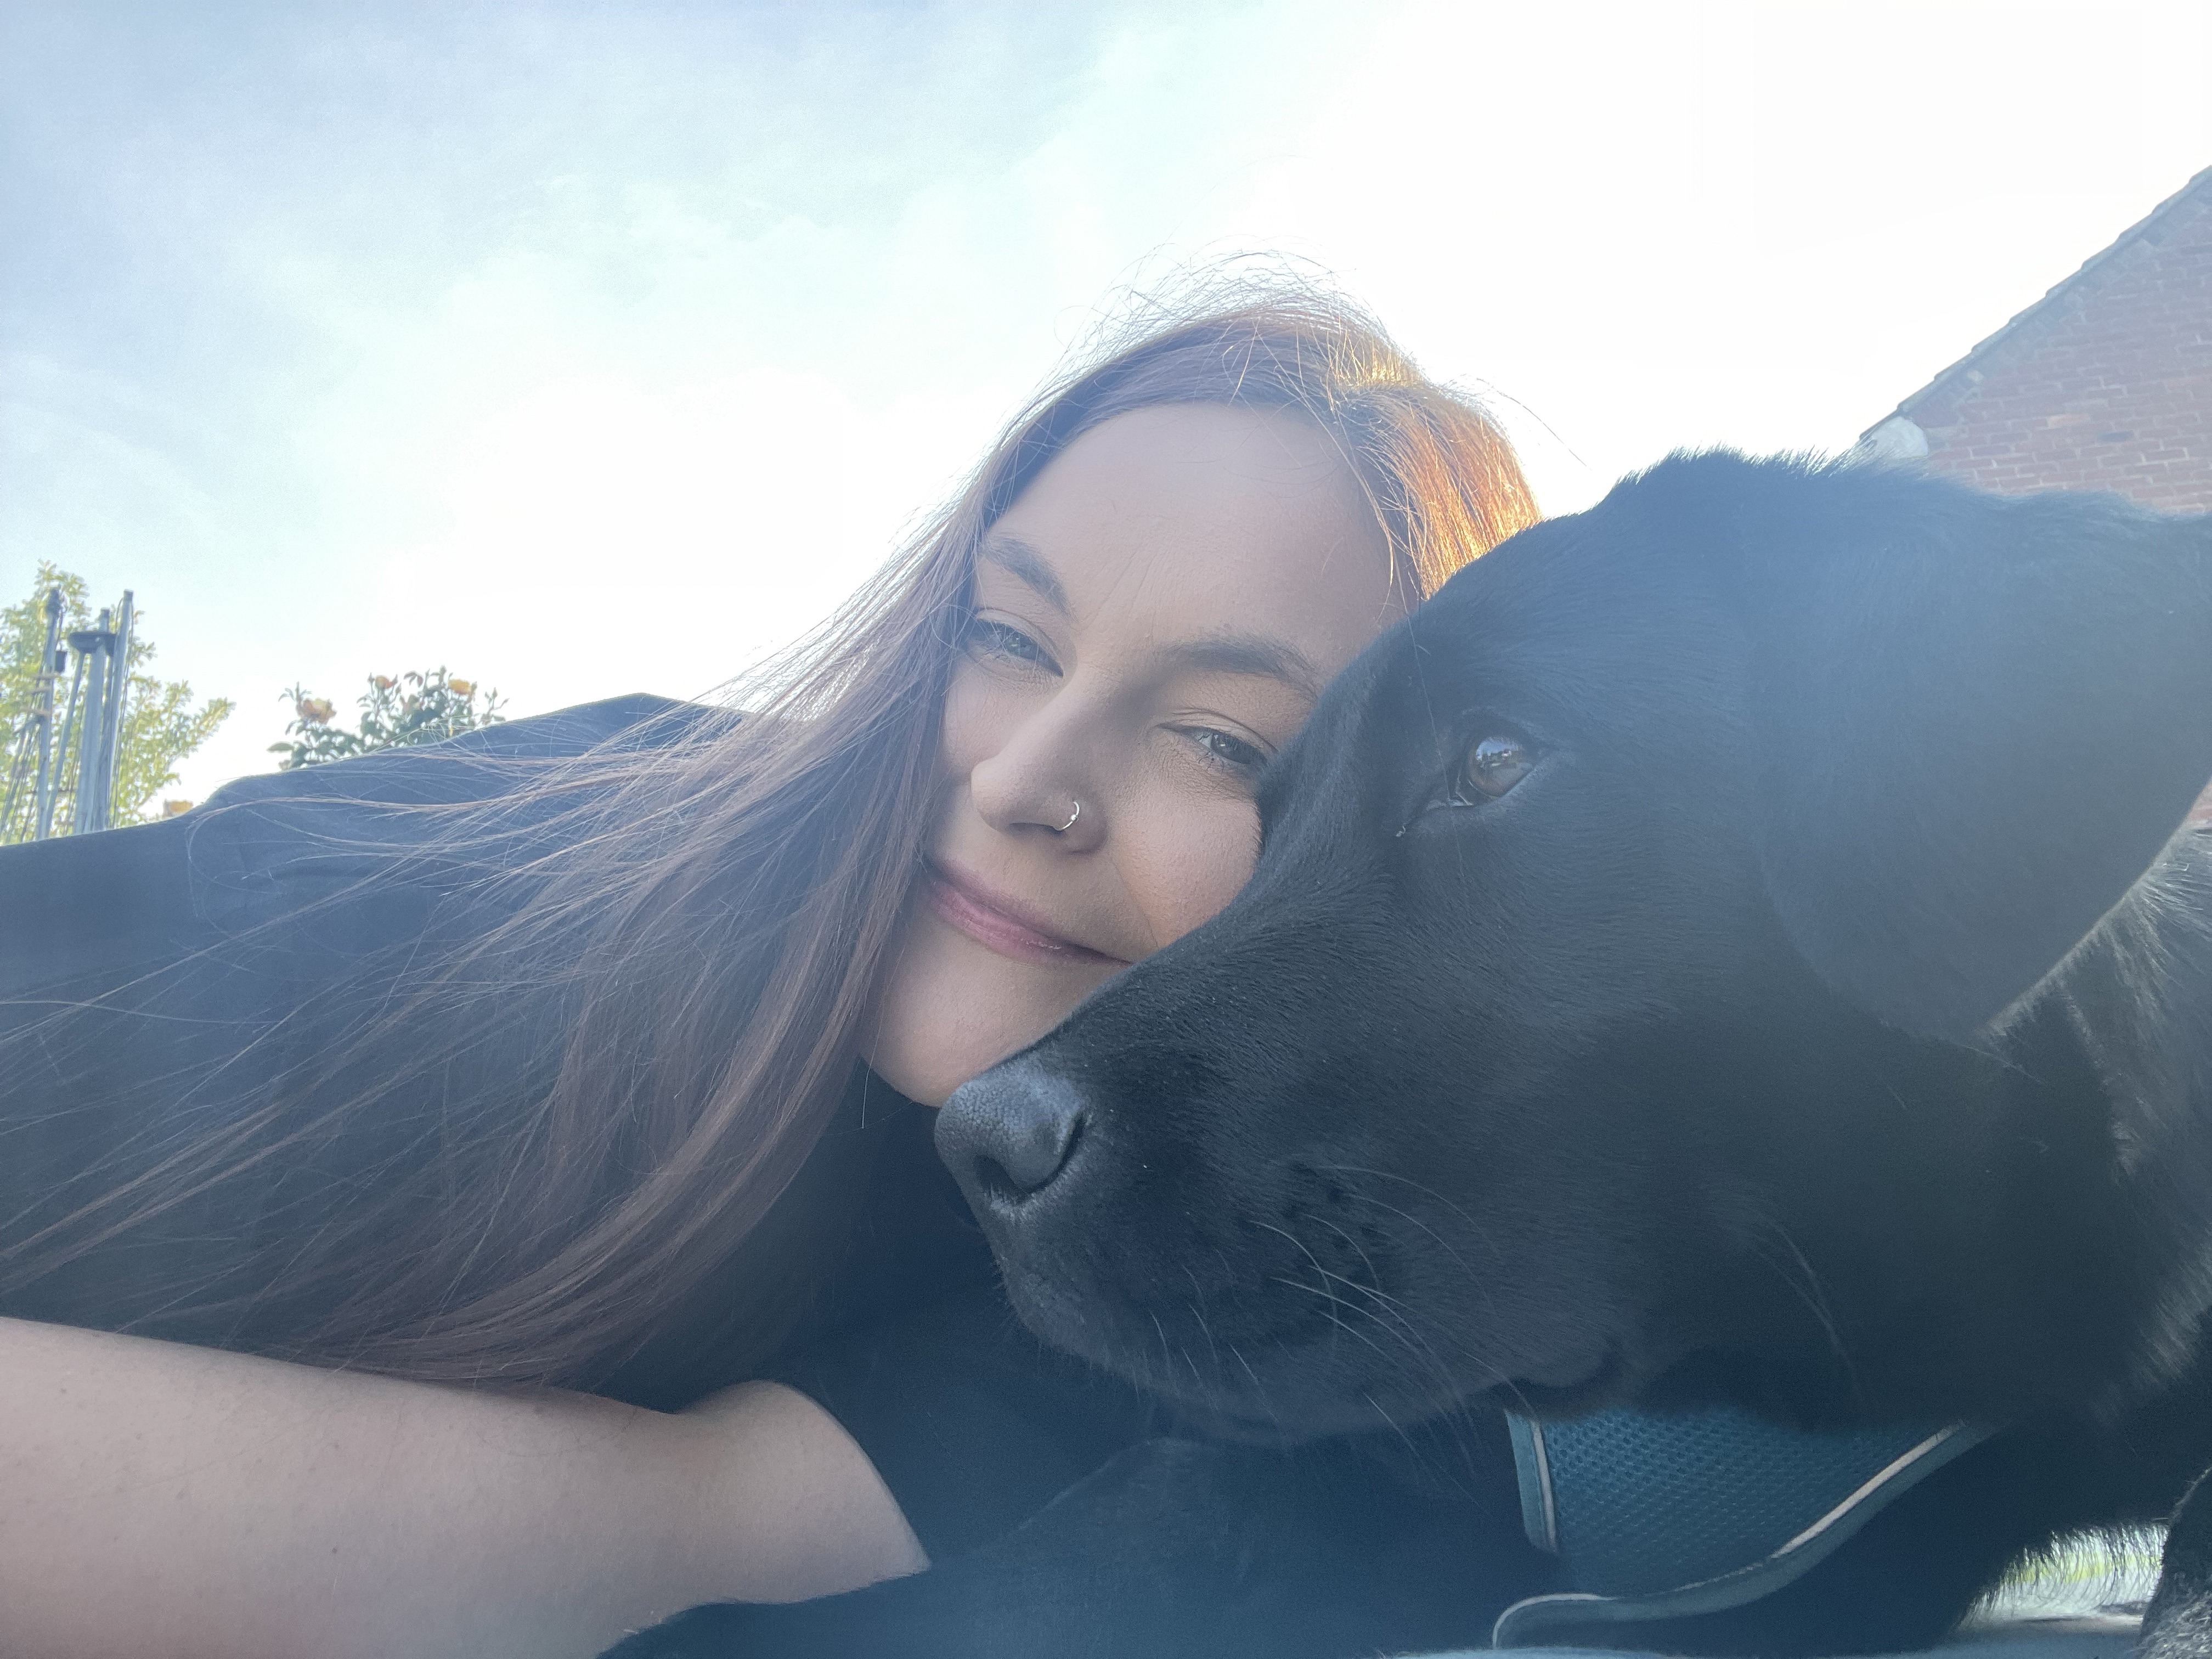
I love to spend time with my family and take my daughter Harper to see animals!
I love to go on walks with my dog, Otis.
My favourite book is Naughty Bus.
My favourite colour is pink.
My favourite food is any pasta dish!
Hello! My name is Miss Holland and I am very excited to be one of your Reception Class Teachers and start your school journey with you.
I have been a teacher at The Grove for 4 years and I love it! Everyone is friendly, helpful and polite. Our Class will be ‘Gosling Class’ and it will be filled with so many wonderful, exciting learning opportunities.
I can’t wait to get to know you. We are going to have so much fun!
I very much welcome and value parental involvement and communication throughout the year. Please contact me with any questions you have.
kholland@grove.cambs.sch.uk

