Slide 1
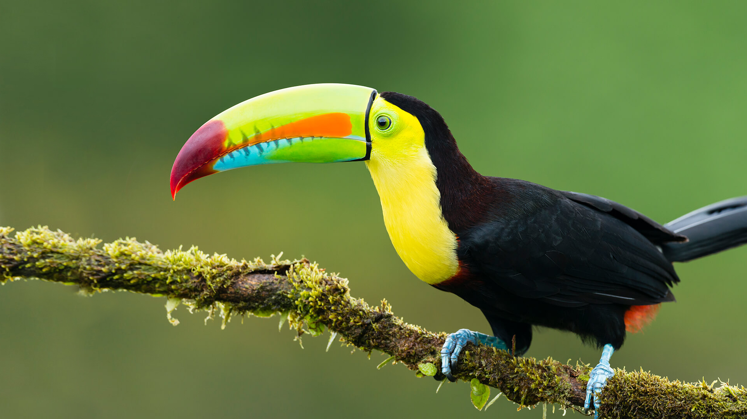
This term in…
Toucan Class
English (Writing)
We are reading ‘The Island’ by Armin Greder and using it as inspiration to write our own narrative through exploring the themes of refugees and human rights. We will use this book to learn how to use modal verbs, the passive voice, the present perfect tense and subordinate clauses in our narrative.
Maths
We will firstly be revisiting fractions to look at how to multiply (Y5/6) and divide (Y6) fractions by an integer. We will also be recapping how to simplify fractions and how to convert improper fractions to a mixed number. After that, we will begin to cover decimals and percentage (Y5/Y6).
Science
This term we will be learning about Earth and Space. We will investigate how the Earth moves in space and how the view of scientists has changed over time. We will explore the Earth’s relationship with Sun and Moon, as well as the other planets in our Solar System.
RE
This half-term we will be answering the question, “What does it mean for a Jewish person to follow God?” To do this we will explore the unique aspects of Judaism as well as the similarities it shares with other old religions. We will look in detail at the importance of the Torah.
Computing
We will be covering databases this half term. We will start by creating paper-based databases before moving onto computer databases where we will use search tools, compare different data sets. Finally, we will start to look at how databases work in real life.
History
We will be learning all about life in Ancient Greece! We will learn how historians and architects have used artefacts to learn about life in Ancient Greece to uncover facts about the past. We will use historical sources to look at timelines, the pottery and myths and legends from the time.
PSHE
We will be thinking about what we would like to be when we are older while examining different types of careers and their value to society.
PE
This half-term we will be learning the skills needed to practice gymnastics. We will be practicing jumps, rolls and handstands.
Music
We will be learning how to perform and compose music using pitch, rhythm, pulse and form. We will focus on the Ukulele by following Hugh Boyd’s book Rainbow Ukulele.
French
We will be learning the vocabulary for animals so we can describe what pets we have. We will be speaking, reading and listening in each lesson.
Art
We will be learning about Expressionism. We will explore the art work of artists such as Henri Matisse and André Derain. We will investigate their use of unrealistic colour and how it can evoke different emotions. We will be evaluating our own expressionist artwork.

