Slide 1
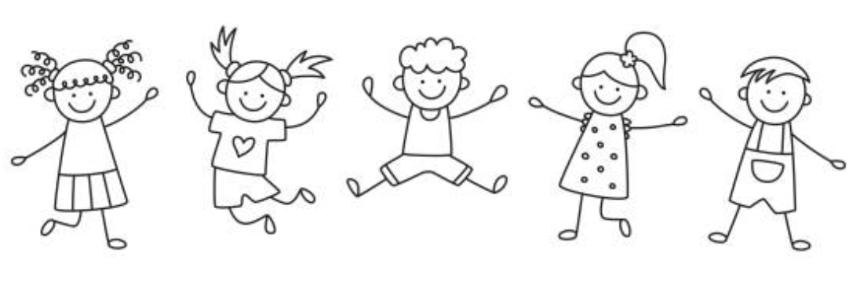
Our theme this half term is…
All about me!
Drawing Club (Writing)
We will be focusing on these texts: Little Red Hen, Not Now Bernard, Goldilocks, A dark, dark tale, Three Little Pigs and We’re going on a bear hunt. We will use these books to learn how to mark make, write sounds and begin to write words.
Maths
We will be focusing on a range of Maths topics this half term including: Numbers/ counting in the environment Subitising Counting skills (Stable order and one to one correspondence)
Phonics
We will be learning: Phase 2 graphemes: s, a, t, p, i, n, m, d, g, o, c, k, ck (diagraph), e, u, r, h, b, f, l. We will also be learning tricky words: is, I, the. We will learn how to orally blend sounds into words. We will also learn how to decode and blend to read words.
Expressive Arts and Design
Creating with Materials: Drawing self portraits, Print making, Collaging, Two artist studies: Kandinsky and Jackson Pollock. Being Imaginative and Expressive: Singing, describing sounds, selecting instruments and play in time to a beat, moving to different musical rhythms and tempos.
Understanding the World
Understanding the world is split into 3 sections: The Natural World, Past and Present and People, Culture and Communities. The Natural World (science link): Exploring our senses and discovering, sorting, classifying Minibeasts. Past and Present (history link): We will be talking about members of our immediate family and community and creating timelines. (Geography link): Exploring school grounds, creating maps, exploring globes. People, Culture and Communities (RE link): We will be exploring ‘What makes people special?’ including: families, friends, role models, Moses and Jesus.
PSED
Jigsaw PSED unit: Being Me in My World.
PE
Move safely around a space, follow instructions, follow a path, taking turns, working with a partner.
Music
Develop control of singing voice. Take turns in musical activities and songs.

