Slide 1
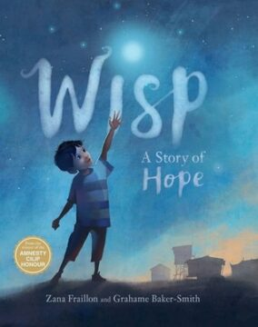
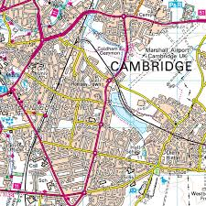
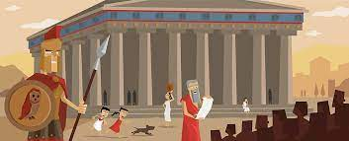
Year 6
English (Writing)
We will be reading Wisp – a story of hope and of appreciation of the stories, memories and experiences of those people in refugee camps and detention centres around the world. The pupils will be writing their own narrative Wisp adaptations. We will then move onto writing persuasive speeches unit using the text ‘Talking History: 150 years of world-changing speeches’.
Maths
We will building on our fractions knowledge. The pupils will be looking at equivalent fractions, comparing and ordering them. Then moving onto fraction and decimal equivalents. Once these concepts has been taught, the pupils will look at fractions, decimals and percentages, before moving onto calculating percentages and then go onto look at properties of shapes.
Science
This half-term we will be building on the knowledge of Magnets and Forces. We will continue to be investigating and devising experiments that prove or disprove a hypothesis. As well as building our knowledge and understanding of reliable and unreliable data.
RE
This half-term we will be looking at the religion of Christianity and the big question: ‘ Do Christian celebrations and traditions help Christians understand who Jesus was and why he was born?
Computing
We will be looking at how webpages are constructed and designed, learning some simple HTML language and using this to create our own webpages.
History / Geography
In History the pupils will be learning all about life in the period of the Ancient Greeks. We will be understanding the ancient civilisation and their legacy within history. In Geography the pupils will be building on their learning of map references which includes reading 4 and 6 grid references.
PSHE
Our unit of work is Celebrating Differences where we will be learning about: accepting that we are all different, dreams and goals to make the world a better place.
PE
This half-term half of Year 6 will be developing our Tag Rugby skills. The other half will be developing their swimming skills focusing on various strokes and water safety.
Music
Pupils will be learning how to compose and perform music using more complex form arrangements.
French
We will be building on the use of the French language on the topic of Healthy Living (Manger et Bouger). The pupils will be learning the names of healthy foods.
Art
We will be looking at the topic of Expressionism and investigate a range of artists. The pupils will be looking at how art can relate to how real images are distorted and exaggerated in order to express their inner feelings. They will be looking at Henri Matisse.

