Slide 1
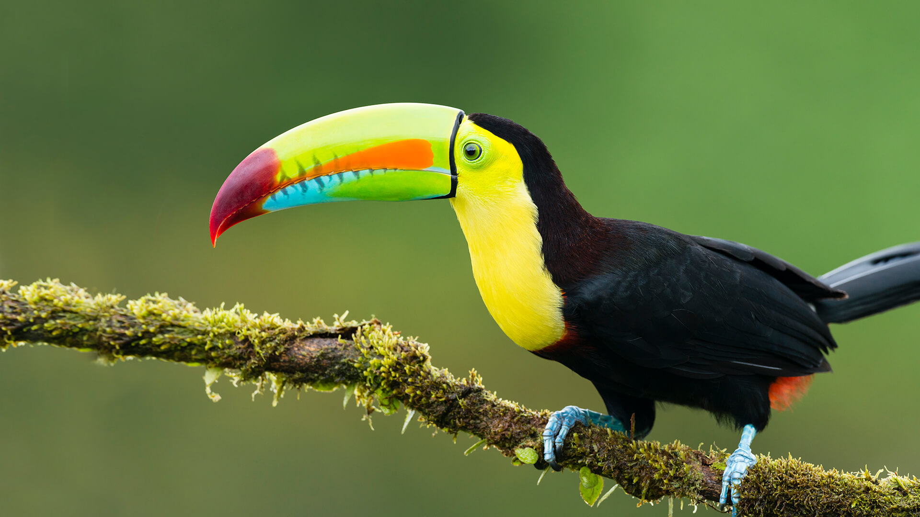
This term in…
Toucan Class
English (Writing)
We will be reading ‘The Watertower’ by Gary Crew and Steven Woolman and using it as an opportunity to write a descriptive recount. After this, we will read ‘The Misadventures of Fredrick’ by Ben Manley and Emma Chichester Clark to write persuasively. Throughout these lessons, we will look at genre features, compositional choices according to writing purpose, sentence level, word level including punctuation and grammatical terminology.
Maths
We will continue our work on fractions this half –term by comparing, ordering, adding, subtracting, multiplying and dividing fractions. We will then use our knowledge to move into decimals and percentages. As well as this, we will have the opportunity to measure volume and capacity, and recognise 3-D and 2-D representations. Throughout these lessons we will be constantly looking at opportunities to improve our reasoning and problem-solving skills.
Science
This half- term we will be learning about Earth and Space. We will continue to be investigating and devising experiments that prove or disprove a hypothesis. As well as building our knowledge and understanding of reliable and unreliable data. We will start the half-term by recapping our knowledge of Space before looking in more detail at Earth’s place within the solar system and it’s relationship with the Sun and Moon.
RE
This half-term we will be answering the question, “What is the best way for a Muslim to show commitment to God?” To do this we will explore the word commitment and learn some ways in how Muslims show commitment, like through prayer, helping the poor and fasting.
Computing
We will be covering Microbits this half term. We will start by looking at what a Microbit is and how we can use it safely. Then, we will begin to writing our own programming which we can transfer onto the microbit. Eventually, we will be able to our programming skills write messages and even make short animations.
Geography
We will be learning all about Biomes to understand the diversity of plants, animals, climates and landscapes exist around the world. We will be looking at different Biomes and understanding that what lives there depend on a variety of factors like how warm or cold it is, how dry or wet it is and how fertile the soil is.
PSHE
Our unit of work is dreams and goals where we will be learning about the importance of being aspirational and recognising what is important.
PE
This half-term we will be doing dance with Mr. Tinkler. On Fridays, we will be learning the importance of rhythm and movement when being active.
Music
We will be further learning about the origin and style of Hip-hop music to influence our own musical compositions using the online resources of Yumu.
French
We will be doing “As-tu un animal?” with native speaker Mrs. Ougana. We will learn new vocabulary around pets and animals through French.
Art
We will be looking at the relationship between Art and Fashion. As always, we will investigate a range of artists, look at what styles of art influenced fashion and explore how expressionist artists inspired fashion designers.

