Slide 1
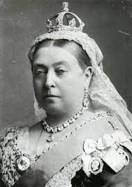
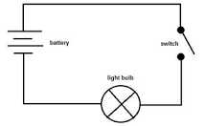
Our theme this term are..
Victorians and
Circuits
English
We will be using ‘The Three Little Pigs’ advert and using it as inspiration for our final written outcome of letters to a newspaper expressing a range of views. We will be gathering our ideas through news reports, persuasive speeches, narrative from a particular point of view, diaries, debates, and newspaper headlines. We will use these opportunities to explore journalistic writing by identifying viewpoints.
Maths
We will be learning the concept of how Fractions, Decimals and Percentages are linked and how to use them in real life contexts. Year 6 will then move on to learning about Area, Perimeter and Volume before moving onto Statistics. Alongside this we will look at the concept of geometry. Where we look at Angles in triangles, quadrilaterals and polygons.
Science
This half-term we will be learning about circuits and how the components fit into them. We will also be learning the symbols used to create circuit diagrams. We will be investigating at the impact of batteries/ cells on a circuit
RE
In our RE we are looking at ‘Christianity – How does belief in ‘God the creator’ influence Christians today. We will look at different types of festivals and celebrations and discuss what they demonstrate about Christianity and why it is a strong religion today.
Computing
They will be exploring the concept of variables and relate them to real-world examples of values that can be set and changed. Then use variables to create a simulation of a scoreboard. They will then experiment with variables and design to improve their games in Scratch
History
We will be learning the Victorians and how it was an important era of invention and exploration. We will be looking at the impact of the industrial revolution alongside the positive and negative consequences of the British Empire.
PSHE
We will be thinking about a ‘Healthy Me’. The pupils will be looking at: healthy choices they make, balanced diets, physical exercises, managing stress and pressure.
PE
This half-term we will be learning about Netball and how to develop a range of skills: team work, positions, footwork, passing and shooting skills.
Music
We will be learning how to perform and compose music using pitch, rhythm, pulse and form. We will also be continue learning how learn to compose a piece of music.
French – Year 6
We will be learning about ‘The Weekend’. Ask what the time is and tell the time accurately. They will learn how to say what they do at the weekend.
Art
We will be designing and building bridges using key features such as Vouissers and keystones. In Art we will be exploring cultural tradition through Kimbo.

