Slide 1
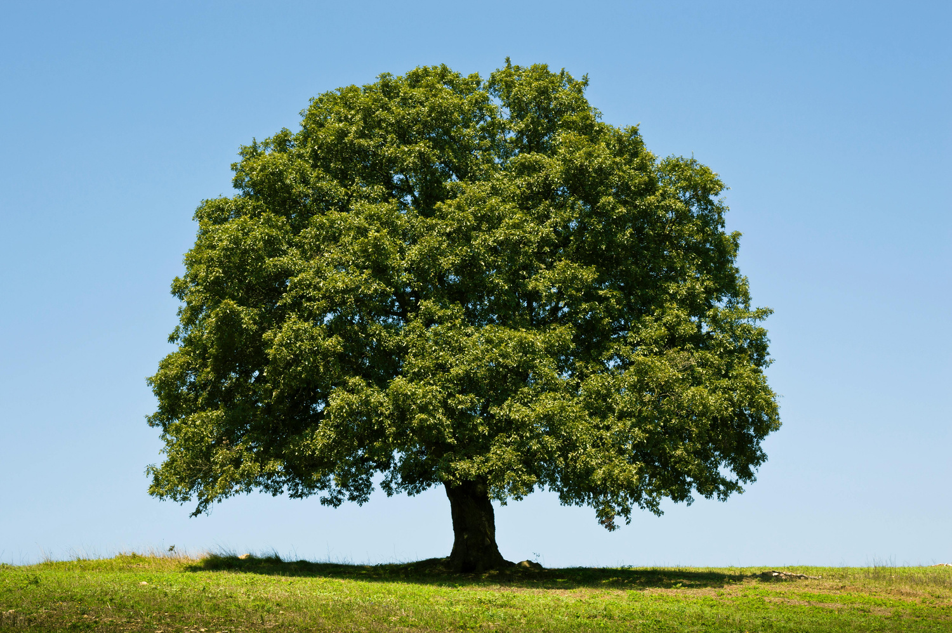
Our themes this half term are..
Nature and local learning.
English
We will be continuing to work on using expanded noun phrases in story telling to elaborate further on our ideas to create a clear, engaging short story for our chosen audience. We will then go on to explore the use of similes in poetry and how to incorporate this into a poem structure to create an entertaining poem for our chosen audience.
Maths
In Maths we will continue to explore written methods for addition and subtraction and telling the time to the nearest 15 minutes. We will then move on to explore different strategies using multiplication and division skills, linking it to some of our prior learning from Year 2. We will use our multiplication and division skills we learn to answer written problems.
Science
Our Science focus this half term is about plants. We will recap our prior knowledge of the different parts of a plant and learn their functions. We will be experimenting with different conditions to see what is best for a plants growth and learning how water travels through plants.
RE
We will be looking at the importance of Jesus coming back to life after his crucifixion to Christians. We will also be investigating the events leading up to his crucifixion.
Computing
We will be using computers to digitally programme quizzes. We will look at how we can create and design a programme and review our work to find out its effectiveness.
History / Geography
We will be studying Local History and Geography with a focus on important landmarks and Cambridge Alumni for our History learning. In Geography, we will be looking at landmarks in Arbury and using our prior knowledge of creating a route to make a more detailed map showing how to get to a chosen destination.
PSHE
We will be exploring our healthy me topic. We will be talking about what our bodies need to be healthy, different ways to stay relaxed and how we can use different medicines safely. We will be linking this to our Science work from Spring 1 where we looked at healthy foods and their food groups.
PE
Our PE focus this half term is all about gymnastics. We will be learning how to move our bodies in different and fun ways. Using balancing, jumping and rolling to travel around the space and create sequences of movements.
Music
Music will be continuing weekly with Mr Randall. Our focus will be learning how to create harmonies using instruments. We will be continuing to warm ourselves up at the beginning of each sessions by practicing singing in a round to practice vocal harmonies.
Art / DT
In Art we will be looking at the paintings of Henri Rousseau and creating our own jungle-inspired collage art based on his work. Our DT focus this half term will be looking at how to design and make sliders.

