Slide 1
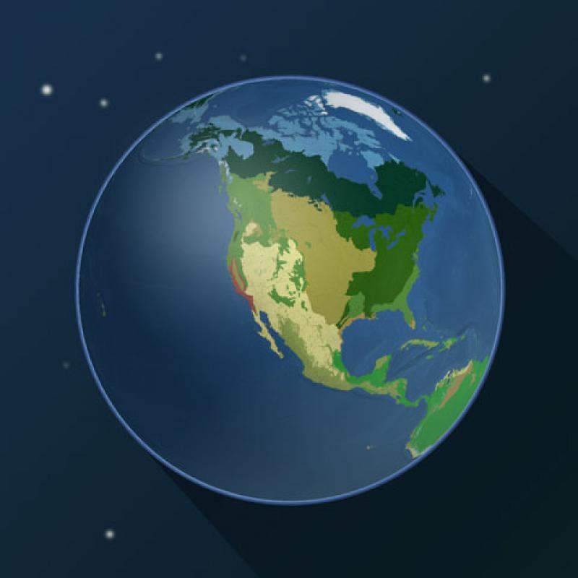
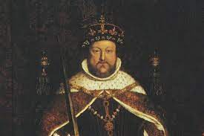
Our theme this term are..
Biomes and
Victorians
English
We will be reading ‘The Lost Happy Endings’ and using it as inspiration for our final written outcome of a prequel to explain the witches backstory and the reasons she committed the terrible crime of stealing the happy endings. We will be gathering our ideas through writing diaries, letters and speech.
Maths
We will be continuing with our work on fractions looking at equivalence, ordering and comparing fractions and mixed numbers. We will also be adding and subtracting fractions and finding fractions of amounts. Finally we will begin looking at decimals.
Science
This half-term we will be learning about circuits and how the components fit into them. We will also be learning the symbols used to create circuit diagrams. We will be investigating at the impact of batteries/ cells on a circuit
RE
This half term we will be answering the key question ‘How significant is it for Christians to believe that God intended Jesus to die?’. We will look at the events of Holy Week (the week leading up to the death and resurrection of Jesus) to investigate the cause and effects of these events
Computing
We will be writing codes to control external devices so that they will light up in different ways and in sequences.
History
We will be learning the Victorians and how it was an important era of invention and exploration. We will be looking at the impact of the industrial revolution alongside the positive and negative consequences of the British Empire.
PSHE
We will be thinking about Healthy Choices regarding things such as smoking and alcohol and how they can make informed decision about whether or not they choose to do them.
PE
This half-term we will be doing gymnastics. We will be learning to do individual and partner balances, rotation jumps and a variety of rolls.
Music
This term, we will be exploring tempo through composing, singing and performing
French – Year 6
We will be learning about habitats.
Art/DT
We will be designing and building bridges using key features such as Vouissers and keystones. In Art we will be exploring cultural tradition through Kimbo.

