Slide 1
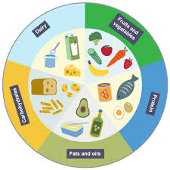
Our themes this term are..
Keeping Healthy!
English
We will be continuing to work on using conjunctions and expanded noun phrases in story telling to elaborate further on our ideas to create a clear, engaging picture for our reader. We will then go on to explore how information can be organised into sections and use this to create our own non-chronological report on an animal of their choice.
Maths
In Maths we will be moving on to explore more formal written methods of addition and subtraction, including crossing over tens boundaries. We will apply this to solving simple word problems. We will then begin to tell the time to the nearest 15 minutes.
Science
We will begin this half term by revisiting the five senses. We will also explore how other senses adapt when one is lost, for example how those visually impaired use touch to navigate their everyday life. We will be looking at how to maintain a healthy lifestyle by exploring the main food groups and why they are important, as well as regular exercise.
RE
We will be looking at what might be found in a synagogue and why these might be important to Jewish people. We will also explore what happens at a synagogue as a place of worship.
Computing
We will be using computers to digitally compose music. We will look at how we can create and edit different layers of sound to compose a song.
History / Geography
We will be studying the life of Florence Nightingale and how her work in medicine changed medical care then and how it still has an impact today. In Geography, we will be identifying the differences between climates and countries as well as seas and oceans. We will then go on to explore different climates.
PSHE
We will be exploring dreams and goals. We will be talking about motivation and why this is important to meet a goal. We will be linking this in to our Science work on staying healthy and having fitness goals to motivate us. We will also look at how working together can help motivate us.
PE
We will be having our annual swimming sessions, where we will be revisiting water safety as well as developing our swimming skills in a variety of different strokes.
Music
Music will be continuing with Mr Randall and for this this half term, we will be learning to play the ukulele! We will be developing our composing skills by using inspiration from our environment.
Art
We will be looking at the paintings of John Ndambo and creating our own African-inspired landscape art based on his work.

